Slide 1
Wireless Water-Tank Level Meter
By- Nupur Sule
Rakshit Mishra
Jaki Polad
Varun Gaonkar

Slide 2
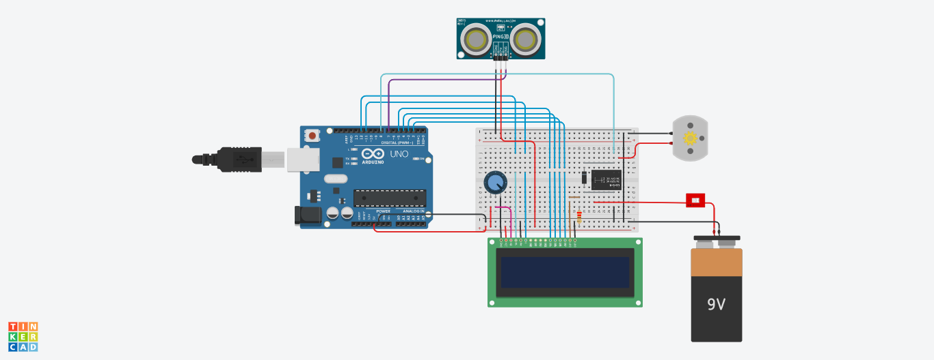
Block Diagram

Slide 3
Working
This project ultrasonic sensor used as tank water level sensor where it will trigger the relay to stop the pump when ever the tank is full.If the tank not full the pump is working normally.Lcd Screen is integrated to display the water level in a percntage level.
The LCD in the receiver unit displays the water level as a long bar.
The water percentage is calculated and displays in the LCD
The back-light of the LCD will turn on once the button is pressed and will turn off after 30 seconds.
When the water level is below 15% alarm buzzes, if it was muted it restarts again when the water level is below 10%, and 5%

Slide 4
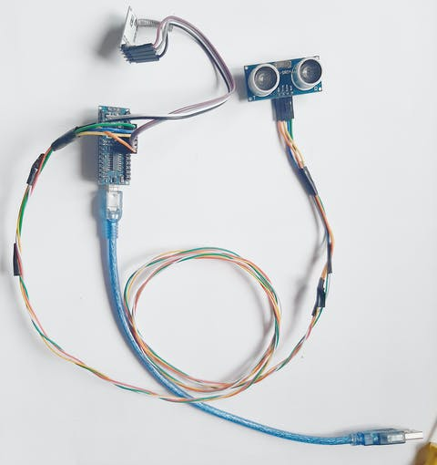
Applications
Can be used in water tanks to control water levels.
Automatically turn ON/OFF pumps.
Can be used in factories, commercial complexes, apartments, home.
Fuel tank level gauging
Oil tank level control.
High & low-level alarms.
Pool water level control

Slide 5
Future scope
This circuit not only indicates the amount of water present but also gives an alarm when tank is full which reduces the over flow of water.
By using solar panels we can monitor water level eve during power cuts.
Automatic water level monitoring system has a good scope in future especially for agriculture sector. There are any areas where we need water level controller. It could be agricultural fields, overhead tanks. We can make this project wireless by using NRF transmitter and receiver.

Slide 6
Durability
One of the main reasons that the electric water controller showed poor durability would fall on the high 600 volts used in a wet environment. ... Causing inaccurate readings, sensor probes will rust at a fast rate, while high mineral content in the water will likely plate to the probes enforcing failure
Addressing the durability problems found in earlier designs, the solid-state electronics in the newer models help to eliminate them. Not only do they help to eliminate the durability issues, but they also create considerable savings of the life span of the unit with an advanced modular design. In order to minimize problem areas of these designs, the only moving parts are the relays. These relays are easily replaced and tested by any skilled operator or electrician while being an inexpensive part.

Slide 7
Components
Name | Quantity | Component
SW1 | 1 | DIP Switch DPST
K2 | 1 | Relay SPDT
PING1 | 1 | Ultrasonic Distance Sensor
D5 | 1 | Diode
U3 | 1 | Arduino Uno R3
U4 | 1 | LCD 16 x 2
Rpot1 | 1 | 250 kΩ Potentiometer
R1 | 1 | 220 Ω Resistor
M1 | 1 | DC Motor
BAT1 | 1 | 9V Battery

Slide 8
Code
// include the library code:
#include <LiquidCrystal.h>
// initialize the library with the numbers of the interface pins
LiquidCrystal lcd(12, 11, 5, 4, 3, 2);
int cm = 0;
int pump = 8;
bool STOP_pump = HIGH ;
bool RUN_pump = LOW ;
void setup()
{
Serial.begin(9600);
pinMode(pump,OUTPUT);
lcd.begin(16, 2);
digitalWrite(pump,RUN_pump);
}
void loop()
{
lcd.setCursor(3, 1);
lcd.print("%");
if( level >=99){
digitalWrite(pump,STOP_pump);
}
else if( level <95) {
digitalWrite(pump,RUN_pump);
}
else {
digitalWrite(pump,STOP_pump); // this is for safety in case.
}
}
// measure the ping time in cm
cm = 0.01723 * readUltrasonicDistance(7, 7);
// convert to inches by dividing by 2.54
int level = map(cm, 400 , 10, 0 , 100);
lcd.setCursor(0, 0);
lcd.print( "Tank Level");
lcd.setCursor(0, 1);
lcd.print(level);

Slide 9
long readUltrasonicDistance(int triggerPin, int echoPin)
{
pinMode(triggerPin, OUTPUT); // Clear the trigger
digitalWrite(triggerPin, LOW);
delayMicroseconds(2);
// Sets the trigger pin to HIGH state for 10 microseconds
digitalWrite(triggerPin, HIGH);
delayMicroseconds(10);
digitalWrite(triggerPin, LOW);
pinMode(echoPin, INPUT);
// Reads the echo pin, and returns the sound wave travel time in microseconds
return pulseIn(echoPin, HIGH);
}

